Slide 1
Department of CSE Honors COURSE NAME: Probability, Statistics and Queuing Theory COURSE CODE: 22MT2005
Topic:
Joint Random Variables, Marginal Probability Functions, Independent Random Variables

Slide 2



AIM OF THE SESSION
To familiarize students with the basic concept of Jointly distributed random variables
INSTRUCTIONAL OBJECTIVES
This Session is designed to:
1. Define Joint random variables and their probability functions
2. Describe Marginal and conditional functions
3. List out the properties of independence of jointly distributed random variables
4. Describe the applications of discrete and continuous for jointly distributed random variables
LEARNING OUTCOMES
At the end of this session, you should be able to:
1. Define joint random variables and their properties
2. Describe Probability functions of jointly random variables
3. Summarize the discrete and continuous case of jointly distributed random variables

Slide 3
JOINT PROBABILITY DISTRIBUTIONS
In real life, we are often interested in several random variables that are related to each other. For example,
suppose that we choose a random family, and we would like to study
the number of people in the family
the household income
the ages of the family members etc.
Each of these is a random variable, and we suspect that they are dependent.
In this session, we will learn tools to study joint distributions of two or more random variables.
The concepts are extensions of what we studied for one random variable in the previous classes.

Slide 4
JOINT PROBABILITY DISTRIBUTIONS
Let A and B be two random variables which are defined on a probability space. The probability distribution that gives the probability that each of A and B falls in any particular range or discrete set of values specified for that variable is defined as the bivariate joint probability distribution for A and B.
The concept when extended to more than two random variables, it is called a multivariate probability distribution.
The random variables can be discrete or continuous.
In this session, we will look at an illustration of a joint probability distribution of two discrete variables.

Slide 5
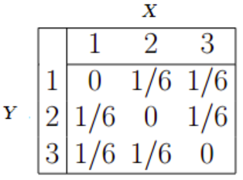
JOINT PROBABILITY DISTRIBUTIONS
Let X and Y be two discrete random variables.
Let their joint probability mass function be denoted as
F(x,y) = P(X = x, Y = y)
The main purpose of the joint distribution is to look for a relationship between the two variables.
The following table (joint PMF) shows the probabilities for events X and Y happening at the same time.
We can use the joint PMF table to find probabilities.
For example:
Question: What is the probability for Y = 2 and X = 3?
Answer: Look at the table for the intersection of Y = 2 and X = 3.
The answer is 1/6, from the above matrix.
Similar idea of joint distribution exists for continuous random variables

Slide 6

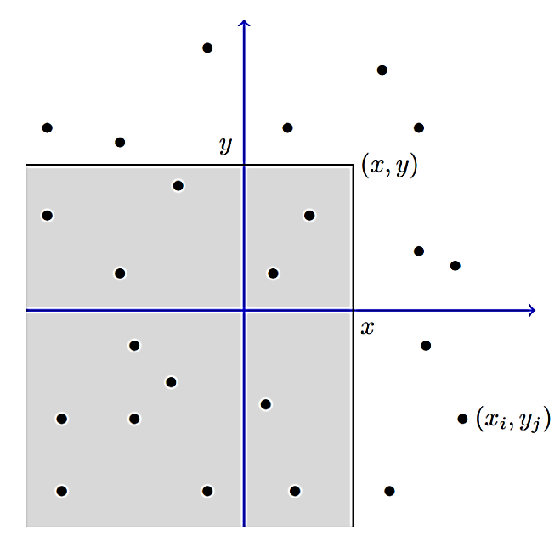
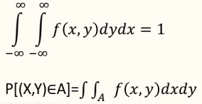
JOINT PROBABILITY DISTRIBUTIONS
Joint Probability distributions: If X and Y are two discrete random variables, the probability distribution for their simultaneous occurrence can be represented by a function with values
f(x,y) = P(X=x, Y=y);
the function f(x, y) is a joint Probability distribution or Probability mass function of the random variables X and Y if
i) f(x,y)≥ 0 for all x and y
ii)
iii) P(X=x,Y=y)=f(x,y)
Joint density function: The function f(x, y) is a joint density function
of the continuous random variables X and Y if
f(x,y)≥ 0 for all x and y, where A is the range of XxY
FXY (x, y) is the probability that (X, Y ) belongs to the shaded region. The dots are the pairs (xi, yj) in RXY

Slide 7




JOINT PROBABILITY DISTRIBUTIONS
Marginal Distribution: The Marginal Distribution of X alone and of Y alone are
Conditional distribution: Let X and Y be two random variables, discrete or continuous. The conditional distribution of the random variable Y given that X =x is
Similarly, the conditional distribution of the random variable X given that Y=y is
Statistical Independence: Two random variables X and Y, discrete or continuous with joint probability distribution of f(x, y) and marginal distributions g(x) and h(y), respectively.
The random variables X and Y are said to be statistically independent if and only if f(x,y)=g(x)h(y) for all (x,y) within their range.
for the discrete case g(x) = Σ_{𝑦} 𝑓(𝑥, 𝑦) and h(y) = Σ_{𝑥}𝑓(𝑥, 𝑦) | for the continuous case

Slide 8
INDEPENDENT RANDOM VARIABLES
In some cases, the probability distribution of one random variable will not be affected by the distribution of another random variable defined on the same sample space.
In those cases, the joint distribution functions have a very simple form, and we refer to the random variables as independent.
Discrete random variables X₁,X₂,…,X_{n} are independent if the joint pmf factors into a product of the marginal pmf’s:
It is equivalent to check that this condition holds for the cumulative distribution functions.
In terms of events as follows:
In the above, we use the idea that if X and Y are independent, then the event that X takes on a given value x is independent of the event that Y takes the value y.
Note: If X and Y are independent random variables, then E[XY]=E[X] E[Y] .

Slide 9
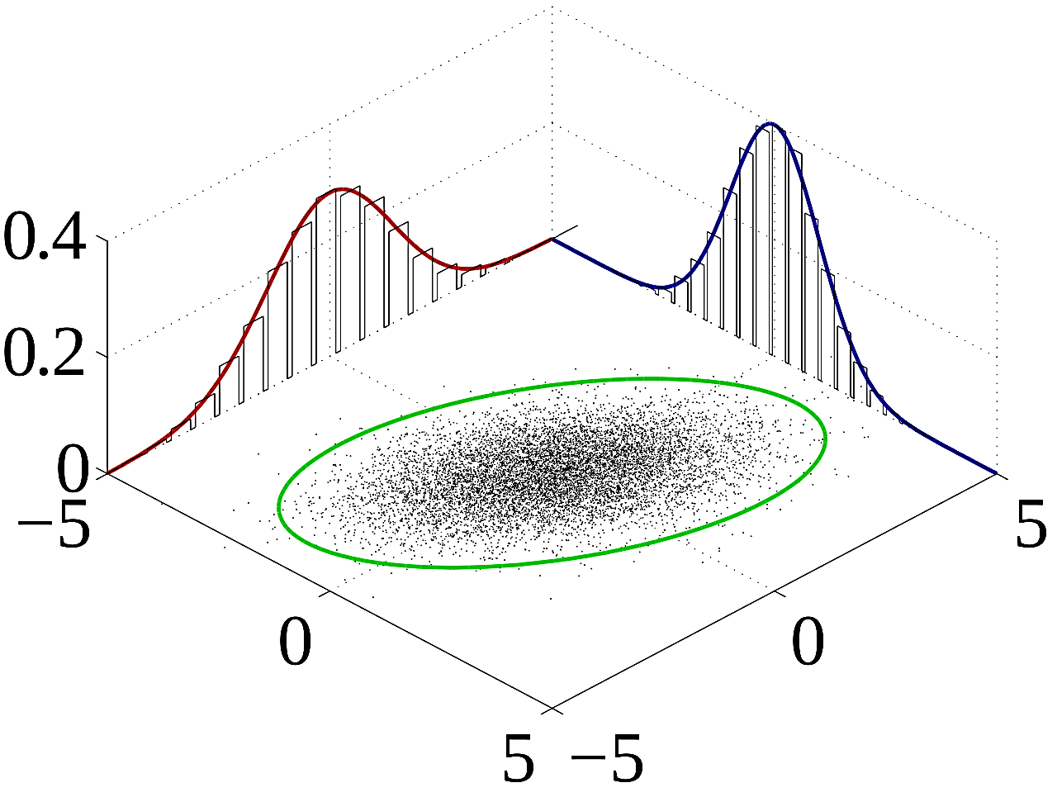



IMPORTANT FACTS
Properties of Expectation and Variance
Mean of a joint probability Distribution:
Let X and Y be random variables with joint probability Distribution f(x, y). The mean or expected value of the random variable g(X, Y) is
if X and y are discrete
if X and y are continuous
Joint Cumulative Distribution Functions (Joint cdf)
Many sample observations (black) are shown from a joint probability distribution. The marginal densities are shown as well.

Slide 10
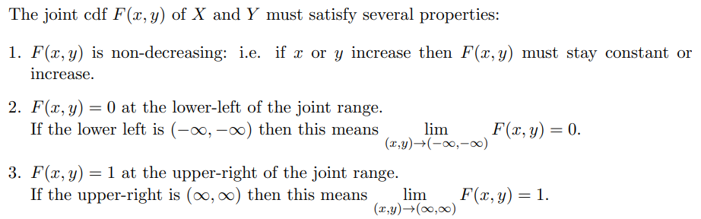
PROPERTIES OF THE JOINT CDF

Slide 11
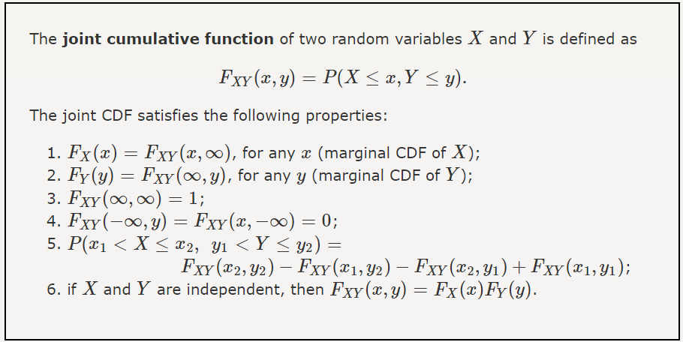
PROPERTIES OF THE JOINT CDF

Slide 12
Example (Discrete)
Two scanners are needed for an experiment. Of the five available, two have electronic defects, another one has a defect in the memory, and two are in good working order. Two units are selected at random.
a) Find the joint probability distribution of X1=the number with electronic defects, and X2 = the number with a defect in memory. b) Find the probability of 0 or 1 total defects among the two selected. c) Find the marginal probability distribution of X1. d) Find the conditional probability distribution of X1 given X2=0.
Solution:
a) Joint distribution of X1 and X2
or symbolically the joint distribution of X1 and X2 is
²c_{x1} × ¹c_{x2} × ²c_{x1-x2} for x1 = 0,1,2, x = 0,1 and 0 ≤ x1 + x2 ≤ 2 ⁵c₂
 | X1
X2 |  | 0 | 1 | 2
X 2 | 0 | 1/10 | 4/10 | 1/10
 | 1 | 2/10 | 2/10 | 0

Slide 13
Example (Discrete)
b) Probability of total defects is 0 and 1
=P(x1=0 and x2=0) + P(x1=0 and x2=1) + P(x1=1 and x2=0)
=1/10 + 2/10 + 4/10 =0.7
c) Marginal probability distribution of X1 and X2 Let f 1(x1) and f2(x2) be the marginal distribution of X1 and X2 respectively. They are shown in the following table
 |  | x1 | x1 |  | f(x2)
x2 |  | 0 | 1 | 2
x2 | 0 | 1/10 | 4/10 | 1/10
 | 1 | 2/10 | 2/10 | 0
 |  | 3/10 | 6/10 | 1/10
f(x1)

Slide 14

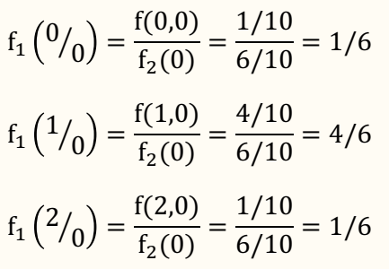
Example (Discrete)
d) The conditional distribution of X1 given X2=x is defined as
The conditional distribution of X 1 given X2=0 is given by

Slide 15

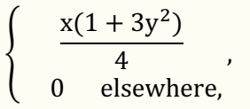

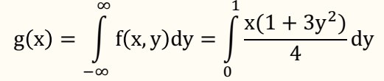
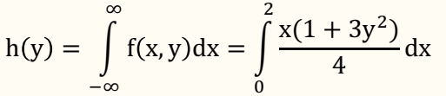
Example (Continuous)
Given the joint density function
f (x, y) = where 0 < x < 2, 0 < y < 1
find g(x), h(y), f(x/y), and evaluate P((1/4 < 𝑋 < 1/2) / Y = 1/3 ).
Solution: By definition
and = (1+3y²)/2 , 0 < y < 1

Slide 16


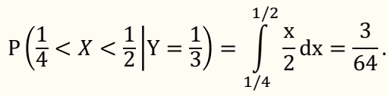
Example (Continuous)
Therefore,
and
So,

Slide 17
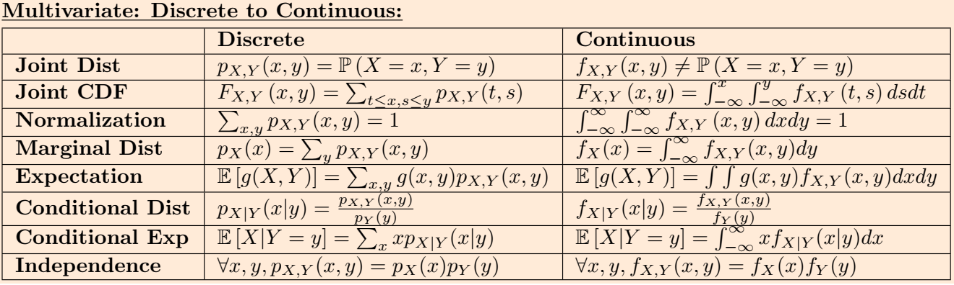
Related Formulas

Slide 18
SUMMARY
In this session, the concepts of Jointly distributed random variables and its applications have discussed
1. Define Joint probability distribution function for discrete and continuous
2. Applications of Joint random variables in various applications of real life have observed.

Slide 19
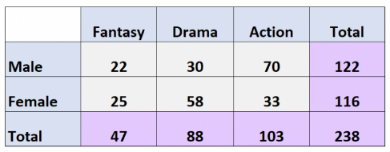
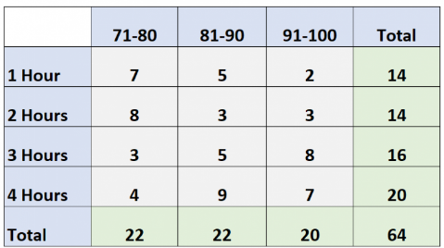
SELF-ASSESSMENT QUESTIONS
The following two-way table shows the results of a survey that asked 238 people which movie genre they liked best. What is the probability that a given individual is female and prefers Drama as their favorite movie genre?
58/238
25/116
25/238
58/116
The following two-way table shows the exam scores of 64 students in a class based on how many hours they spent studying. What is the probability that a given individual studies for 2 hours and receives a score between 91 and 100?
8
3/64
8/64
3/14

Slide 20
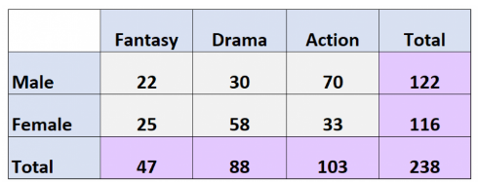
SELF-ASSESSMENT QUESTIONS
3. The following two-way table shows the results of a survey that asked 238 people which movie genre they liked best:What is the marginal distribution for movie genre (in percentages) for Drama?
19.7%
43.3%
37%
None of these
4. What is the marginal distribution for gender (in percentages)?
Male: 51.3%
Female:48.7%
Both (a) and (b)
None of the above

Slide 21
TERMINAL QUESTIONS
Explain the joint probability distribution and marginal probability distributions.
List out formulas for joint probability distribution and marginal probability distributions.
Suppose (X, Y ) takes values on the square [0, 1]×[1, 2] with joint pdf f(x, y) =8/3x³y. Find the marginal pdf’s f_{X}(x) and f_{Y} (y).
The joint cdf is F(x, y) = ½ (x³y+xy³) on [0, 1] ×[0, 1].Find the marginal cdf’s and use F_{X}(x) to compute P(X < 0.5).
Suppose X has range [0, 1/2], Y has range [0, 1] and f(x, y) = 96x²y³ then X and Y are independent. Find the marginal densities functions of the f(x, y).

Slide 22
REFERENCES FOR FURTHER LEARNING OF THE SESSION
Reference Books:
Section 5.1, 5.2 of TS1: Alex Tsun, Probability & Statistics with Applications to Computing (Available at: http://www.alextsun.com/files/Prob_Stat_for_CS_Book.pdf)
Hossein Pishro-Nik, Introduction to Probability, Statistics, and Random Processes-Kappa Research, LLC (2014)
K S Trivedi, Probability and Statistics with Reliability, Queuing and Computer Science Applications, Wiley
Sites and Web links:
https://www.probabilitycourse.com/chapter5/5_1_0_joint_distributions.php
https://www.probabilitycourse.com/chapter5/5_2_0_continuous_vars.php
https://www.statisticshowto.com/joint-probability-distribution
https://byjus.com/maths/joint-probability

Slide 23
THANK YOU
Team – PSQT

